Slide 1


Introduce the HandOver of LTE
SPEAKER：邓丰
TEAM： S1

Slide 2
General
Target eNB
Source eNB
MME
2 HANDOVER Request
1 HANDOVER REQUIRED
4 HANDOVER COMMAND
3 HANDOVER REQUEST ACKNOWLEDGE
(Handover Preparation)
(Handover Resource Allocation)
HANDOVER NOTIFY
(Handover Notification)

Slide 3
General
HandOver is very important in the telecommunication and maybe a little complicate
Process:
1 Handover Preparation√
2 Handover Resource Allocation√
3 Handover Notification
4 Path Switch Request
5 Handover Cancellation
6 eNB Status Transfer
7 MME Status Transfer

Slide 4
1 Handover Preparation
For a certain UE, at the same time ,only one Handover Preparation procedure
Aim: request the preparation of resources at the target side
Method: via the EPC

Slide 5
1 Handover Preparation
(1) Successful Operation
(2) Unsuccessful Operation
(3) Abnormal Conditions

Slide 6
1 Handover Preparation
Source eNB
MME
Handover required
Handover command
Handover preparation failure
Notes:
Handover required中主要的信息：
1 the Direct Forwarding Path Availability IE ------指示一条直接的数据路径是否是可用的
2 the CSG Id IE and no Cell Access Mode IE-------判断access control 是否是成功的，如果是成功的就将CSG Id传给目标方
3 the SRVCC HO Indication IE----指示切换只准备cs域中的切换
handover command中的主要信息：
1DL GTP-TEID IE and DL Transport Layer Address IE
2 UL GTP-TEID IE and UL Transport Layer Address IE
3 E-RABs Subject to Forwarding List
4 E-RABs to Release List

Slide 7
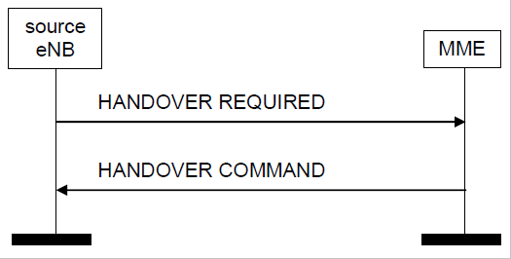
(1)Successful Operation
Notes:
Required中包含的消息：

Slide 8
(1)Successful Operation
Notice:
TS1RELOCprep(与 HandOver Cancellation有关）
TS1RELOCOverall
the Source to Target Transparent Container IE
the Target to Source Transparent Container IE
Notes:
1 从发出required到接受到command为止，这里它还与handover cancellation有关，当在TS1RELOCprep时间快终结的时候还没有收到来自HandOver required的任何反馈，那么source eNB就启动cancel进程来终止前面的HandOver preparation
2从source eNB接收到command开始到切换结束
3包含在handover required消息中，这个container在不同的通信系统和形式中，编码的依据不一样，例如在intra-system handover依据the Source eNB to Target eNB Transparent Container IE，如果切换到UTRAN中，则依据the Source RNC to Target RNC Transparent Container IE
4 这条消息是先从要切换到的地方传到MME，然后再将这条消息放在要返回到source eNB 的command信息中，编码方式和3中的一样

Slide 9
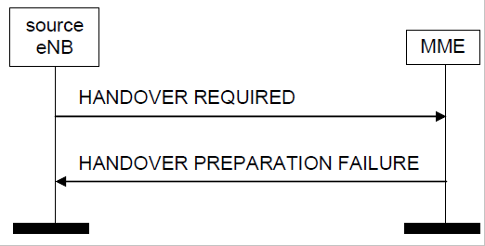
(2)Unsuccessful Operation

Slide 10
(2)Unsuccessful Operation
Reasons:
the EPC or the target system is not able to accept any of the bearers
a failure occurs during the Handover Preparation
the CSG Id IE and no Cell Access Mode IE are received in the HANDOVER REQUIRED message
the access control is unsuccessful

Slide 11
(2)Unsuccessful Operation
Result:
the MME shall send the HANDOVER PREPARATION FAILURE message with an appropriate cause value to the source eNB

Slide 12
(3)Abnormal Conditions
Reasons: eNB接收到的E-RAB ID中的E-RABs Subject to Forwarding List IE没有与之相对应的
（1）DL GTP-TEID and DL Transport Layer Address pair
（2）UL GTP-TEID and UL Transport Layer Address pair
Result: Terminate the procedure as a logical error.

Slide 13
2 Handover Resource Allocation
Purpose:
reserve resources at the target eNB for the handover of a UE.

Slide 14
2 Handover Resource Allocation
(1) Successful Operation
(2) Unsuccessful Operation
(3) Abnormal Conditions

Slide 15
2 Handover Resource Allocation
Target eNB
MME
Handover request
Handover request acknowledge
Handover failure
Notes:
Request中包含的消息：
1 E-RABs to Be Setup List中包含了
E-RAB ID
Transport Layer Address
GTP TEID
E-RAB Level QoS Parameters

Slide 16
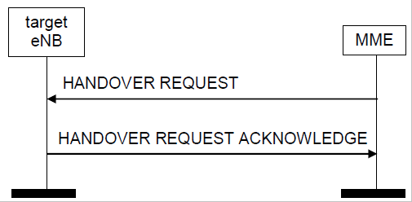
2.1 Successful Operation
Handover resource allocation: successful operation

Slide 17
2.1 Successful Operation
the HANDOVER REQUEST message:
the Handover Restriction List IE
the SRVCC Operation Possible IE
the Trace activation IE
the CSG Id IE
·····

Slide 18
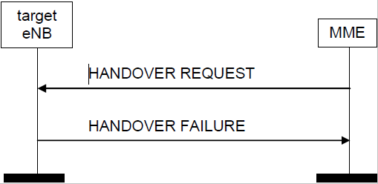
2.2 Unsuccessful Operation
Handover resource allocation: unsuccessful operation
Notes:
the target eNB does not admit at least one non-GBR E-RAB,
2 a failure occurs during the Handover Preparation
3 the target eNB does not receive the CSG Membership Status IE but does receive the CSG Id IE in the HANDOVER REQUEST message and the CSG Id does not correspond to the CSG Id of the target cell
4 the target eNB receives a HANDOVER REQUEST message containing RRC Container IE that does not includerequired information as specified in

Slide 19
2.2 Unsuccessful Operation
Course:
the target eNB does not admit at least one non-GBR E-RAB,
a failure occurs during the Handover Preparation
the target eNB does not receive the CSG Membership Status IE but does receive the CSG Id IE in the HANDOVER REQUEST message and the CSG Id does not correspond to the CSG Id of the target cell
the target eNB receives a HANDOVER REQUEST message containing RRC Container IE that does not include required information .
Notes:
1.目标eNB并不能识别其中的一个non-GBR E-RAB
2.切换准备阶段失败
3目标ENB没有收到CSG Membership Status IE ，但是却收到CSG Id IE 而且CSG ID与目标小区的CSG ID也不符
4 目标eNB接受的是信息中并不是所需要的信息

Slide 20
2.2 Unsuccessful Operation
Result:
the target eNB send the HANDOVER FAILURE message to the MME.

Slide 21
2.3 Abnormal Conditions
In a HANDOVER REQUEST message
1. a E-RAB Level QoS Parameters IE
(1) contains a QCI IE indicating a GBR bearer
(2) not contain the GBR Qos Information IE
2. several E-RAB ID IEs set to the same value
Result :
The eNB shall not admit the corresponding E-RAB.

Slide 22
2.3 Abnormal Conditions
1 The Algorithms in the UE Security Capabilities IE do not match the ones in the eNB
2 The HANDOVER REQUEST message:
(1)not contain the Handover Restriction List IE,
the serving PLMN cannot be determined otherwise by the eNB
(2) contain the Handover Restriction List IE,
the serving PLMN indicated is not supported by the target cell

Slide 23
Result:
the eNB reject the procedure using the
HANDOVER FAILURE message

Slide 24
3 Handover Notification
Purpose:
indicate to the MME that the UE has arrived to the target cell
the S1 handover has been successfully completed

Slide 25
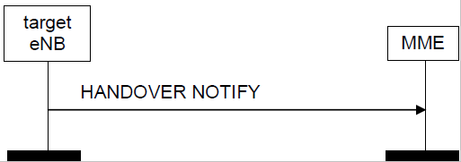
3.1 Successful Operation
Handover notification
Notes:
Notify中主要包含的消息：
1 MME ue s1AP ID
2 eNB UE S1AP ID

Slide 26
4 Path Switch Request
Purpose:
request the switch of a downlink GTP tunnel towards a new GTP tunnel endpoint

Slide 27
4 Path Switch Request
eNB
MME
Path switch request
Path switch request acknowledge
Path switch request failure
Notes:
Switch request 中包含的主要消息：
1 E-RAB to be switch in downlink list中的
E-RAB ID
Transport layer address
GTP-TEID
Acknowledge的主要消息
E—RABs switched in uplink Item IEs
E-RABs to be Released List

Slide 28
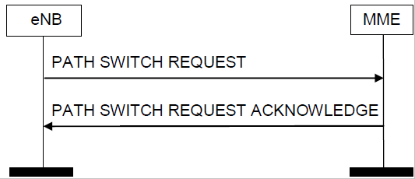
4.1 Successful Operation
Path switch request: successful operation
Notes:
Ackowledge 中的主要消息：
E—RABs switched in uplink Item IEs
E-RABs to be Released List

Slide 29
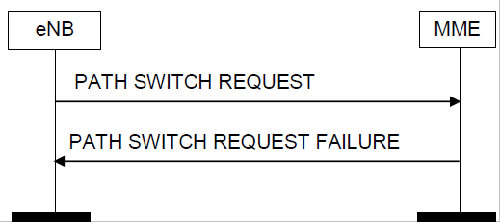
4.2 Unsuccessful Operation
Path switch request: unsuccessful operation

Slide 30
4.2 Unsuccessful Operation
Reason:
the EPC fails to switch the downlink GTP tunnel endpoint towards a new GTP tunnel endpoint
Result:
the MME send the PATH SWITCH REQUEST FAILURE message to the eNB

Slide 31
4.3 Abnormal Conditions
Reason:
the MME receives a PATH SWITCH REQUEST message containing several E-RAB ID IEs set to the same value
Result:
the MME send the PATH SWITCH REQUEST FAILURE message to the eNB

Slide 32
5 Handover Cancellation
Purpose:
enable a source eNB to cancel an ongoing handover preparation or an already prepared handover

Slide 33
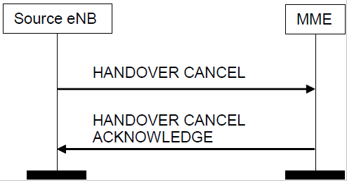
5.1 Successful Operation
Handover Cancel procedure. Successful operation

Slide 34
5.2 Abnormal Conditions
Reason:
the source eNB becomes aware of an expected HANDOVER CANCEL ACKNOWLEDGE message is missing
Result:
the source eNB consider the Handover Cancellation as successfully terminated.

Slide 35
6 eNB Status Transfer
Purpose:
to transfer the uplink PDCP-SN and HFN receiver status and the downlink PDCP-SN and HFN transmitter status from the source to the target eNB
Occur Time:
during an intra LTE S1 handover for each respective E-RAB for which PDCP-SN and HFN status preservation applies
via the MME

Slide 36
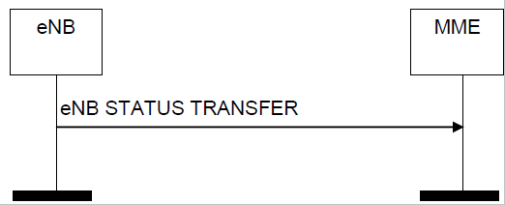
6.1 Successful Operation
eNB Status Transfer procedure

Slide 37
7 MME Status Transfer
Purpose:
to transfer the uplink PDCP-SN and HFN receiver status and the downlink PDCP-SN and HFN transmitter status from the source to the target eNB
Occur Time:
during an S1 handover for each respective E-RAB for which PDCP SN and HFN status preservation applies.

Slide 38
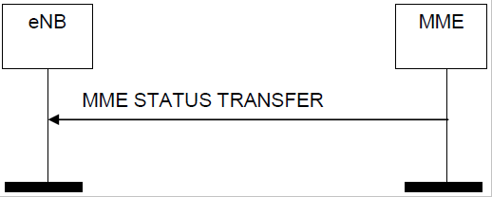
7.1 Successful Operation
MME Status Transfer procedure

Slide 39
7.2 Abnormal Conditions
Course:
the target eNB receives this message for a UE for which no prepared handover exists at the target eNB
Result:
the target eNB ignore the message.

Slide 40
Other Procedures Need Me To Study
S1 CDMA2000 Tunneling Procedures
UE Capability Info Indication
Trace Procedures
Location Reporting Procedures
Warning Message Transmission Procedures
··········

Slide 41
  These procedures maybe more simple than the
  HandOver to us,so I choose some of them
Location Reporting Procedures

Slide 42
Location Reporting Procedures
Location Reporting Control
Location Report Failure Indication
Location Report

Slide 43
Location Reporting Procedures
eNB
MME
Location Reporting Control
Location Report
Location Report Failure Indication

Slide 44
To Be Continued··················

